Slide 1
Weekly Update #9
Gijs Admiraal

Slide 2
Recap from previous weeks
Started exploring topics: atom-by-atom generation, non-standard amino acids (nsAA), (chemical) language models, data augmentation and 3Di
Started creating protein SMILES dataset with RDKit
Created a mind map
Brainstormed and written out scenario#2 All-atom in a diffusion setting
Performed a small data analysis

Slide 3
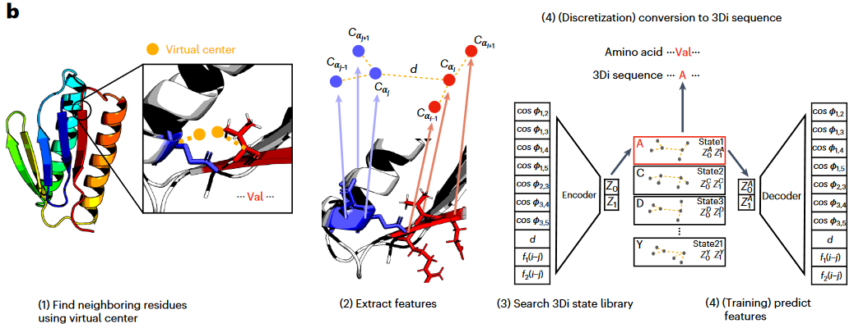
3Di – What is it?

Slide 4
3Di – What is it?
“For FoldSeek, we developed a type of structural alphabet that does not describe the backbone but, rather, tertiary interactions.” ¹
Extracts structural features from a protein and uses an VQ-VAE to convert to 3Di sequence
“To describe the interaction geometry of residues i and j, we extract seven angles, the Euclidean Cα distance and two sequence distance features from the six Cα coordinates of the two backbone fragments (blue and red).” ¹
“the encoder predicts the best matching 3Di state for each residue.” ¹
“To select nearest-neighbor residues that maximize the performance of the resulting 3Di alphabet in finding and aligning homologous structures, we introduced the virtual center V of a residue. The virtual center position is defined by the angle θ, the dihedral angle τ and the length l” ¹

Slide 5
Reasons for all-atom in a discrete diffusion setting
Language models have the ability to generate de novo proteins and large molecules with an all-atom representation^{1,5}
Thus, worth exploring if diffusion models also have this ability
All-atom allows for a new token representation
Compared with algorithms in NLP, protein tokenization methods still remain at a low level without a well-defined and biologically meaningful protein token algorithm (Vu et al., 2022). This may be a direction for unlocking the secrets of proteins.²
All-atom allows for data augmentation³
Discrete diffusion techniques relatively unexplored
Diffusion models with discrete state spaces have been explored for text and image segmentation domains (Hoogeboom et al., 2021) but they have not yet been demonstrated as a competitive model class for large scale text or image generation. ⁴

Slide 6
Scenario #2
What is the performance of training on an all-atom sequence representation using SMILES and how does it compare to other representations such as amino acids sequence when using a diffusion model for de novo generative protein design?

Slide 7
Three directions/sets of experiments
One set of experiments to find/select certain model variables
Architecture, Diffusion Type, Performance Metrics, …
One set of experiments that is comparative of nature
Compare models trained with different representations on different tasks
One set of experiments that is explorative of nature
Explore the strengths and weaknesses of the all-atom representation

Slide 8

Variables
Sequence representations
All-atom representation using SMILES or SELFIES
Functional groups or atom motifs (e.g. $−OH$, $−NH_{2}$or $−CH_{3}$)
Amino acids
Amino acids motifs (e.g. $α$-Helices or $β$-plate )
Architecture types
Transformer
MLP
UNET

Slide 9
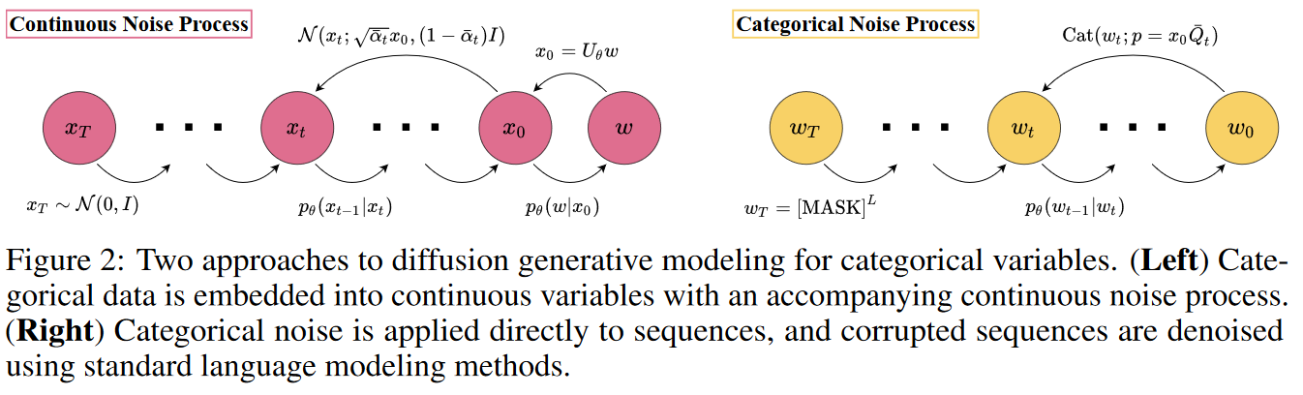
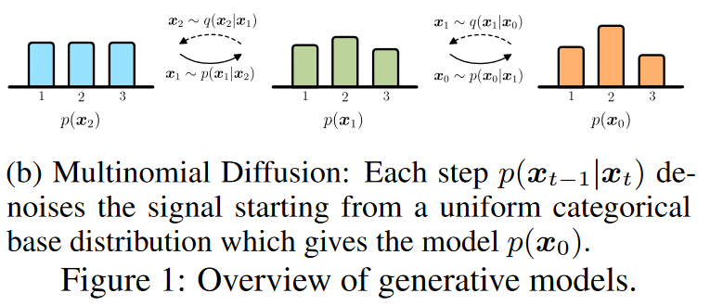
Variables
Discrete diffusion types
Apply categorical noise directly to sequence (use a masking technique)
Apply Gaussian noise to token-vector embeddings
Apply multinomial one hot distribution for amino acid type

Slide 10
Comparative research sub-questions
What is the effect of the models when performing de novo generation and when performing inpainting tasks?
What is the effect of the models when tested on different subsets of proteins lengths?
What is the effect on the model(s) when additional structural information in the form of a 3Di sequence¹ is provided? How should this information be provided?
A co-design approach where sequence and structure is generated together
A conditioning approach where structure information is provided during sampling

Slide 11
Exploratory research sub-questions
What is the effect when the all-atom model uses the data augmentation method as specified by J. Arus-Pous, et al. (2019)¹ ?
What is the effect when the all-atom model is fine-tuned on unnatural sequences. Is it able to correctly learn the training distribution?

Slide 12
Data analysis
On sequences from Swiss-Prot and Protein Data Bank (PDB)

Slide 13
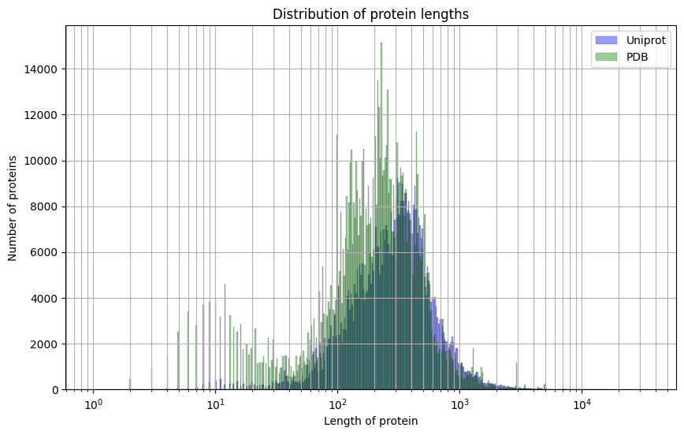
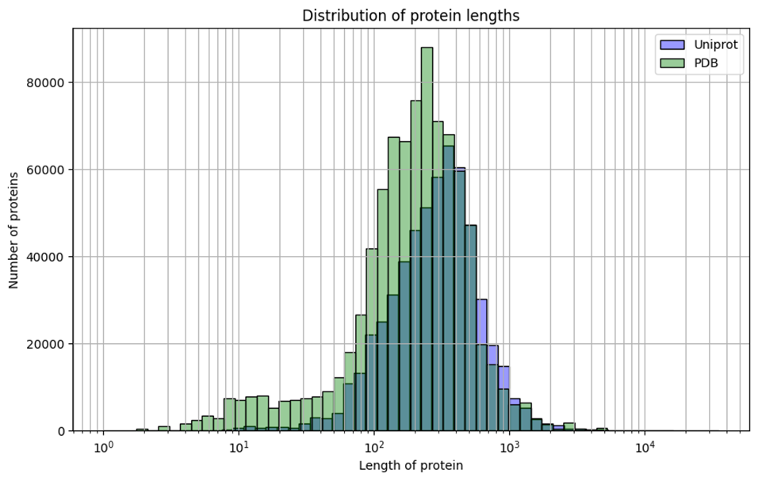
Length Distribution
Note that I forgot to remove similar/replicate sequences or chains

Slide 14
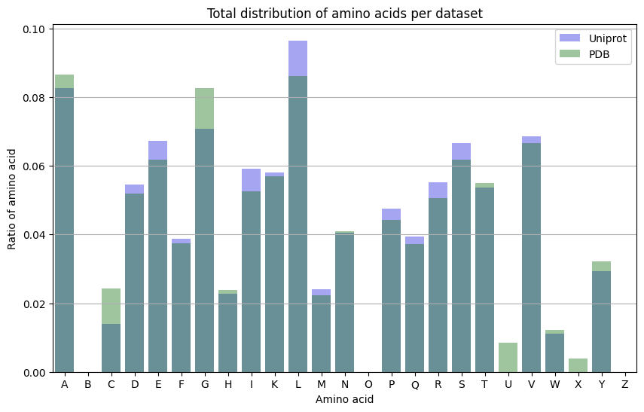
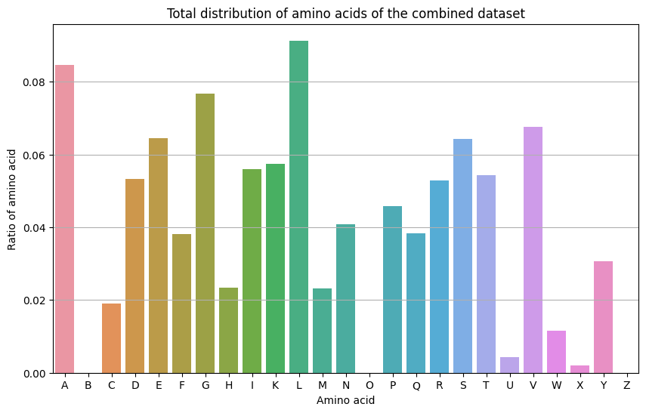
Total amino acid distribution

Slide 15
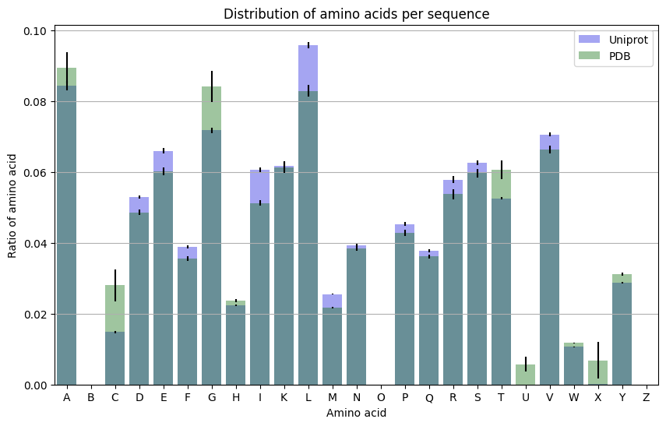
Amino acid distribution per sequence

Slide 16
More (better) data analysis?
How large on average do SMILES sequences get compared to AA sequences?
Check for replicates and chains
Ask Daniel how he created his dataset

Slide 17
Next week?
Do a bit more data analysis
Create a diagram of the architecture
Start writing a bit
Integrate feedback of current meeting

Slide 18
notes

